Slide 1
How “Swiftrunner” can make more Profit ?
For Swiftrunner Private Limited
August 2024
By Navasaji Ramchandra Kudav

Slide 2
Scenario
A “Swiftrunner” is a shoes making company startup founded by Alex Federer & his teammates. Their vision is to not just provide shoes which are look stunning but their quality is also the top notch.
A “Swiftrunner” is a successful small company, but they have the potential to become a larger player in the global market. We have financial data of the year 2014. We have been asked to focus on one of Swiftrunner’s products and analyze sales & profit data to gain insight into how consumers are using their shoes. The insights we discover will then help guide marketing strategy for the company. We will present your analysis to the Swiftrunner’s executive team along with your high-level recommendations for Swiftrunner’s marketing strategy.

Slide 3
Problem : Our sales has dropped in 2014. Create a insight to understand, why ?
Solution :
We will focus on which product is best suitable for particular time period. According to that we will examine each segment’s consumer’s requirement more precisely.

Slide 4
Analytical goals
Why: Understanding the behaviour of data can provide insight about some data patterns and how it’s changing throughout the year.
How: We will filter segment & product that can provide us more insight to understand which product is working & which is not.

Slide 5
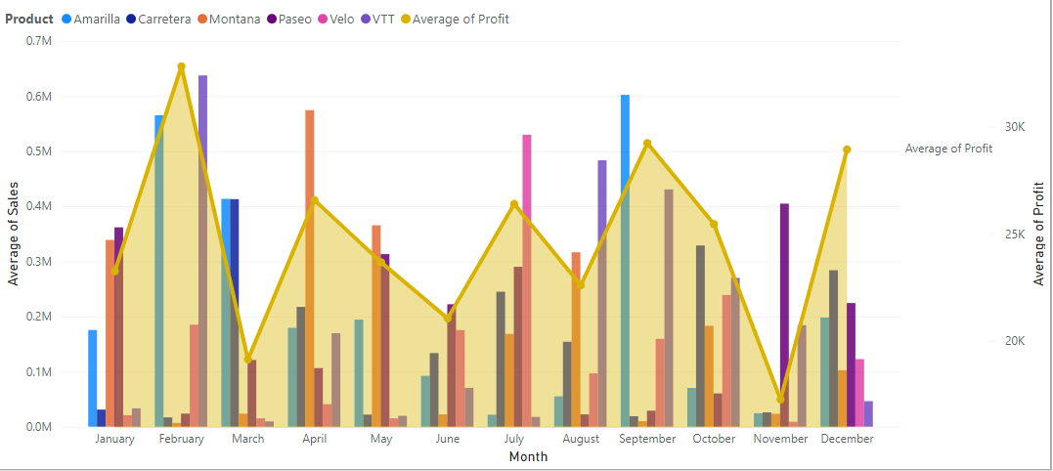
Average of Sales & Average of Profit
By Month & Product

Slide 6
Average Profit & Sales
Pro’s
Con’s
1. As we have seen in the month of February we had maximum average profit over the products.
2. In the month of February we have average profit $ 32,815.64.
1. As we have seen the month of November we had minimum average profit over the products.
2. Where in the month of November we have average profit $17,274.29 with help of product pass

Slide 7
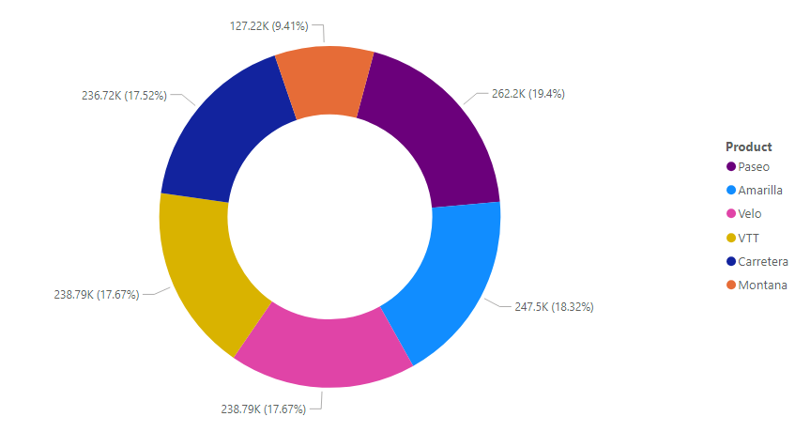
Let’s find product which is best for all seasons :
We have Paseao with maximum profit in all products with 19.4% of share.
While Montana struggling to share minimum profit with 9.41% of share.
Although Amarilla,Velo,VTT,Carretera providing excellent results in the mid with range of 17.50% to 18.50%
Maximum Profit
by Product

Slide 8
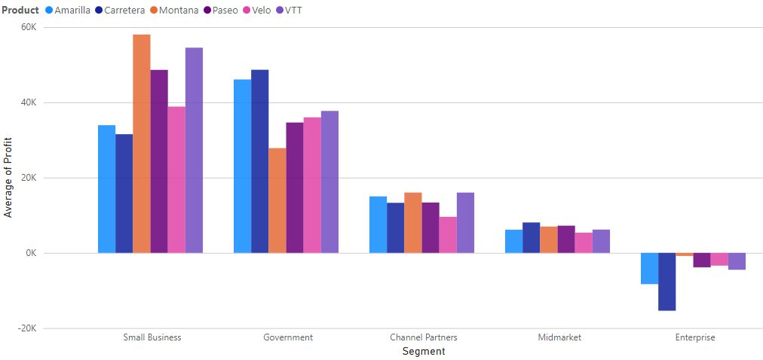
Which Segment we are growing as a company ?
Average of Profit
By Segment & Product
As we can see we are working great in small business & government's.
On the other hand Enterprise segment we are in losses, not even close to our average selling prize.
While the Midmarket and Channel Partners we are doing good but still we need work on those to upscale.

Slide 9
Conclusion :
Why : We are failed to deliver our services in Enterprise Segment, which is resulted in huge losses to
us. If we check other segment’s we are making progress.
How :
We need to create a specific strategy for the Enterprise segment, we can take a sample size by questioning about the product to consumer.
As Paseao is our best selling product from our products, we can share combination offer to consumer with our lowest selling product Montana.
As with only this year data we have limitation to find the trend but we can focus on March and November month in next year.
Last but not the least Olympics is on the next year, we can add up value to our product by making one of each country’s famous athlete as our brand ambassador.

Slide 10
Thank you !

